Slide 1
Bridging the Gap : Pretraining for Multi-Modal Settings
How Pretraining is changing the world
By Hrituraj Singh

Slide 2
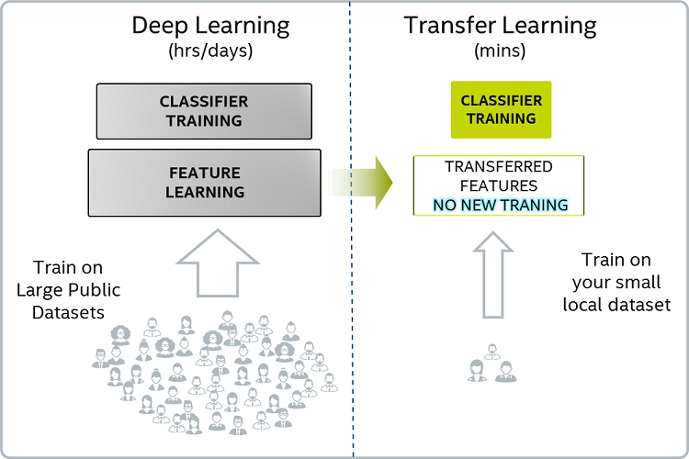
Introduction
ImageNet challenge introduced us to models which after being trained on ImageNet Dataset could be
used for a number of pretraining tasks. This came to be known as Transfer learning.

Slide 3
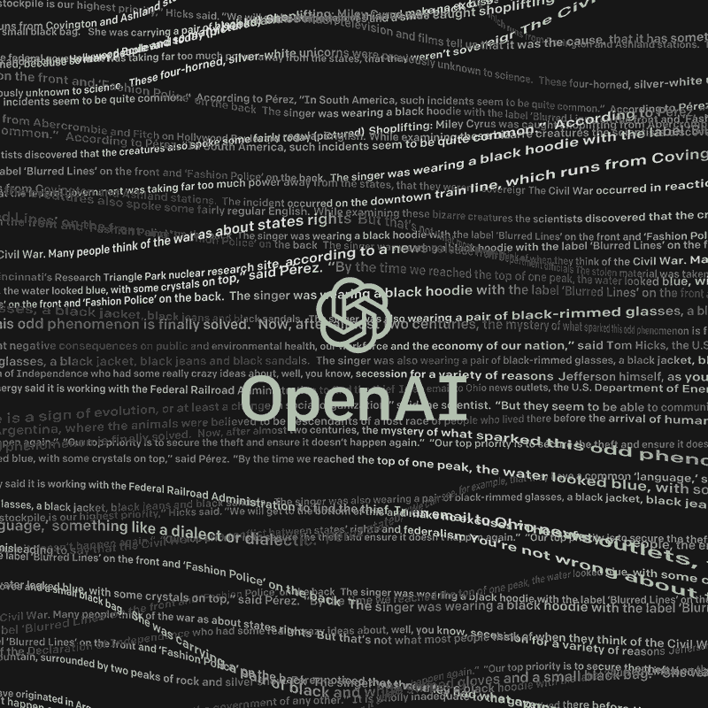
Introduction
This was however earlier limited to Vision up until two years ago when this happened :

Slide 4
Introduction
This was however earlier limited to Vision up until two years ago when this happened :
Improving Language Understanding with Unsupervised Learning – Radford et al.

Slide 5
Introduction
Sea of pretrained models
BERT GPT-2 ELMo

Slide 6
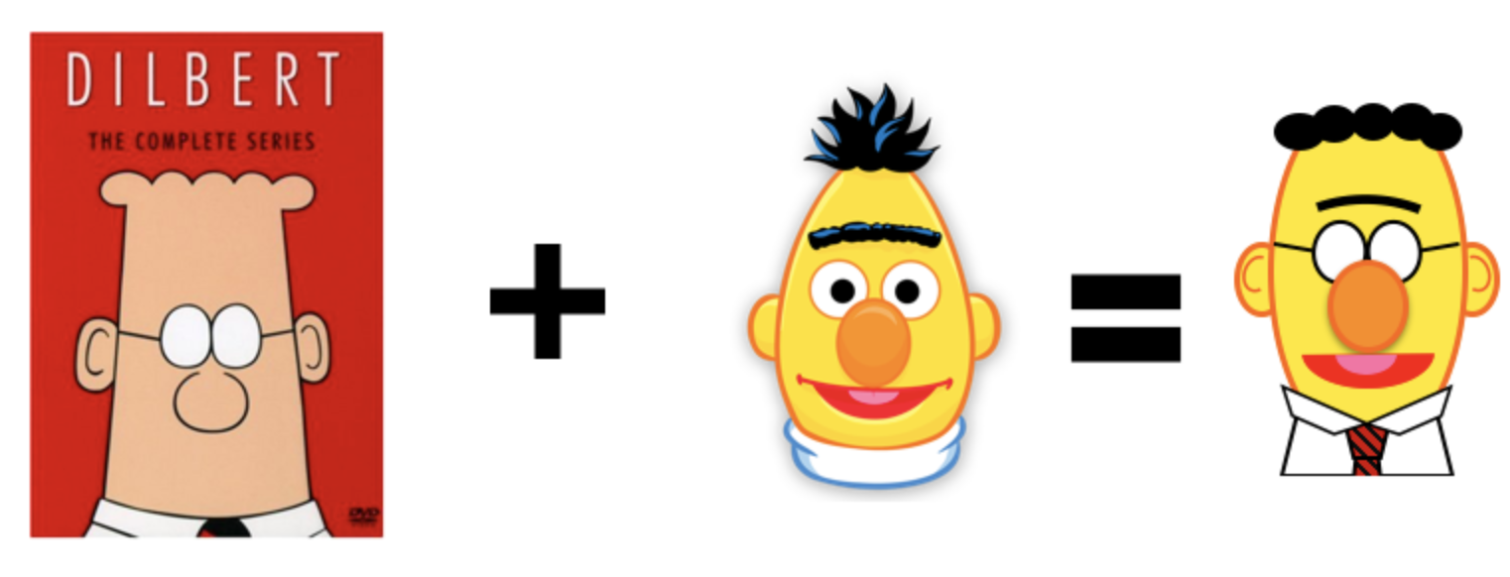
Introduction
What this is about: Vision + Language

Slide 7
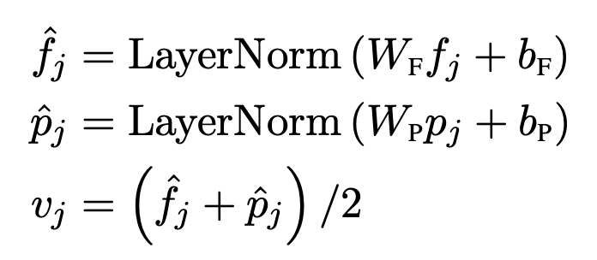
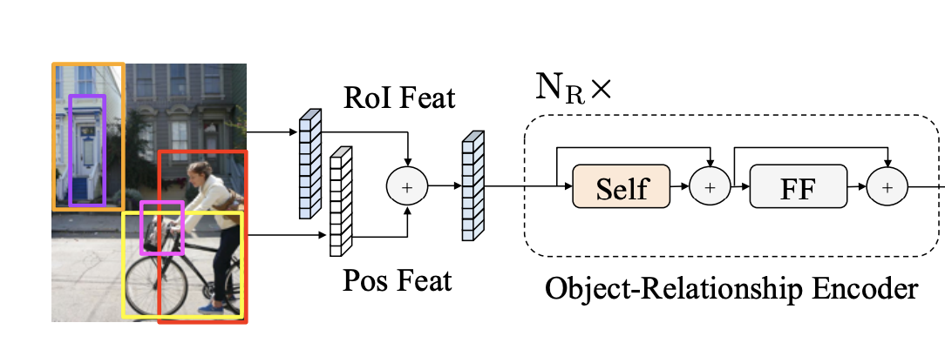
EMNLP 2019 – LXMERT
Encoders : Object Relationship Encoder
1. Detect m objects
2. Get their ROI features and bounding box positions
3. Get the object embedding as :

Slide 8
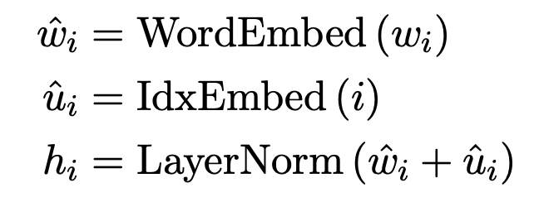
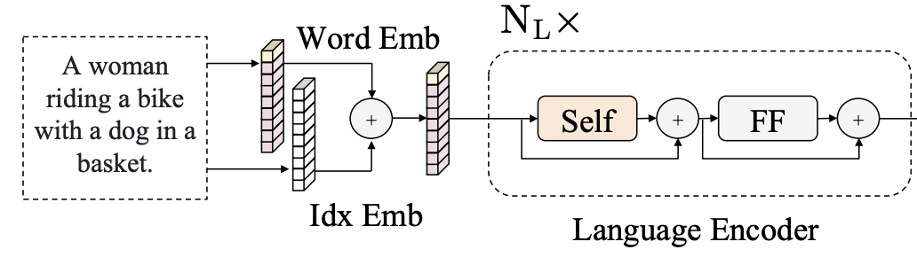
EMNLP 2019 – LXMERT
Encoders : Language Encoder : Basically BERT
1. Get tokens from the sentence/text input
2. Get each word Wi and its index i
3. Get the word embedding as :

Slide 9
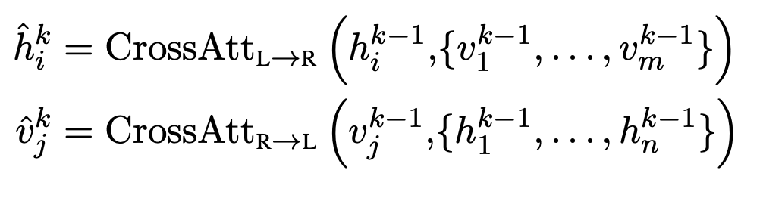
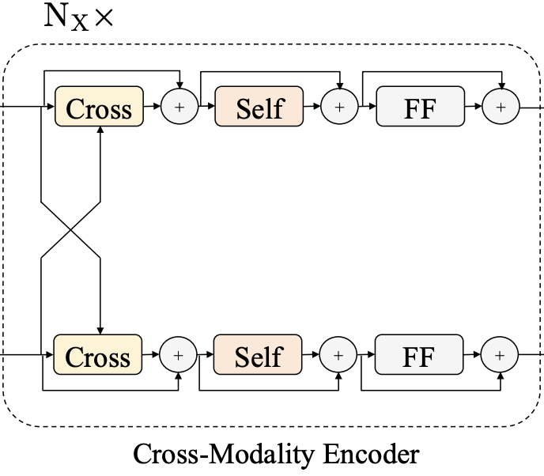
EMNLP 2019 – LXMERT
Encoders : Cross Modality Encoder : Basically Enc-Dec Attention
1. Get contextual embeddings for m objects
2. Get contextual embeddings for n tokens
3. Make them interact as:

Slide 10
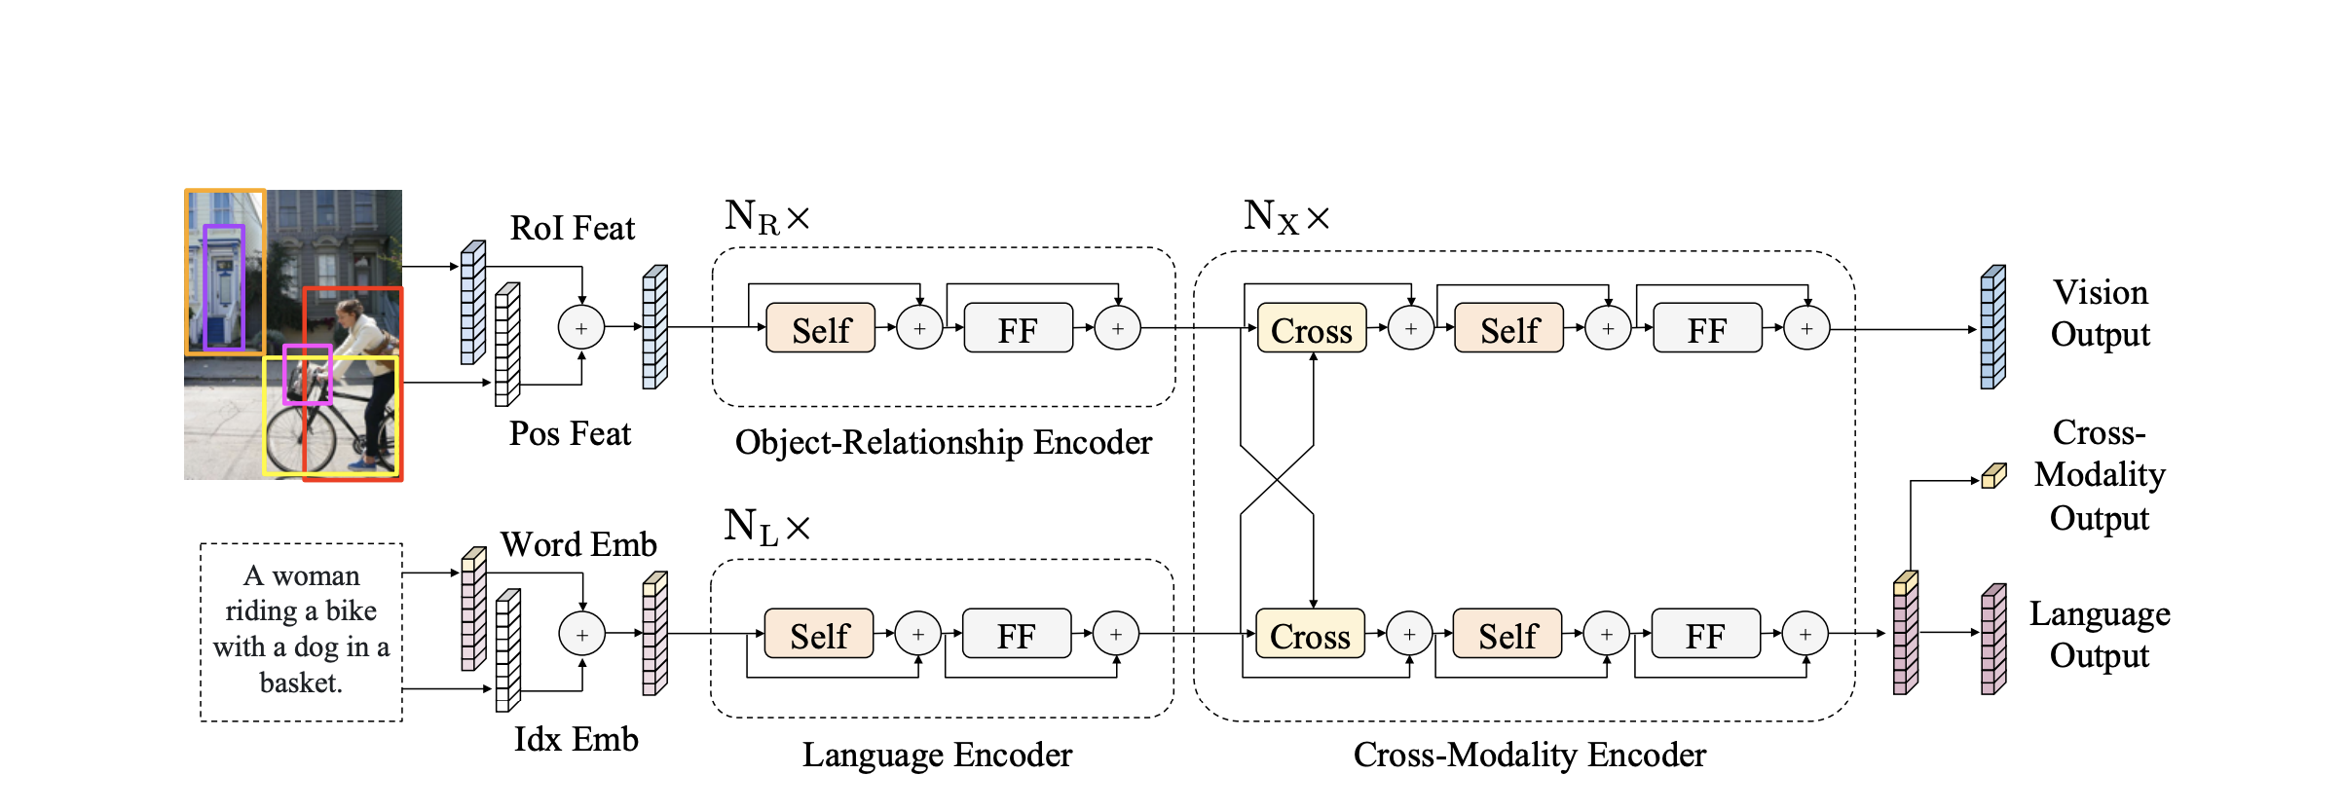
EMNLP 2019 – LXMERT
Encoders : Overall Pipeline

Slide 11
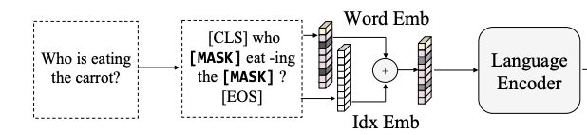
EMNLP 2019 – LXMERT
Pretraining Tasks : Language Task : Masked Language Model

Slide 12
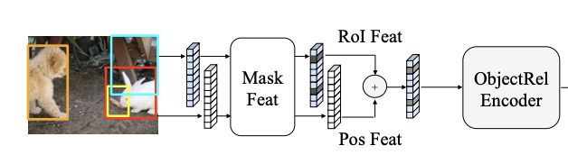
EMNLP 2019 – LXMERT
Pretraining Tasks : Vision Task : Masked Object Prediction

Slide 13
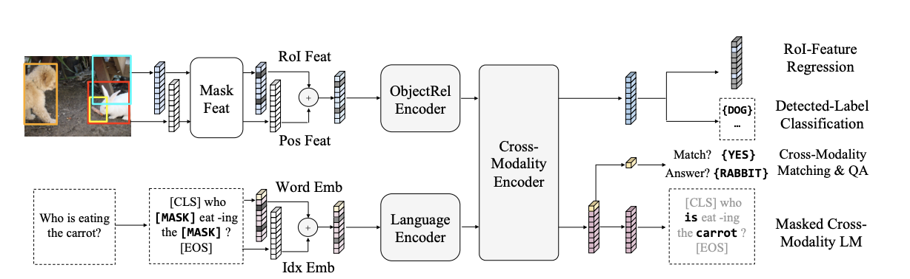
EMNLP 2019 – LXMERT
Pretraining Tasks : Cross Modal Task : Cross Modality Matching and VQA

Slide 14
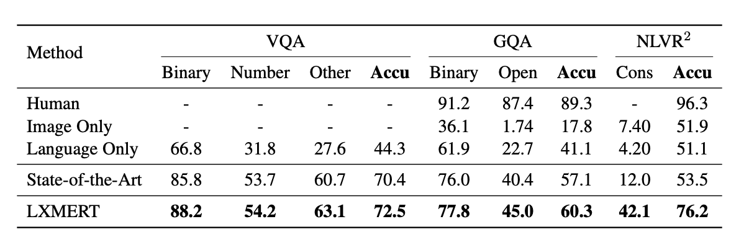
EMNLP 2019 – LXMERT
Results on Downstream Task

Slide 15
Takeaway
[1] Margaret A. Boden. Mind as Machine: A History of Cognitive Science. Oxford University Press, 2008

Slide 16
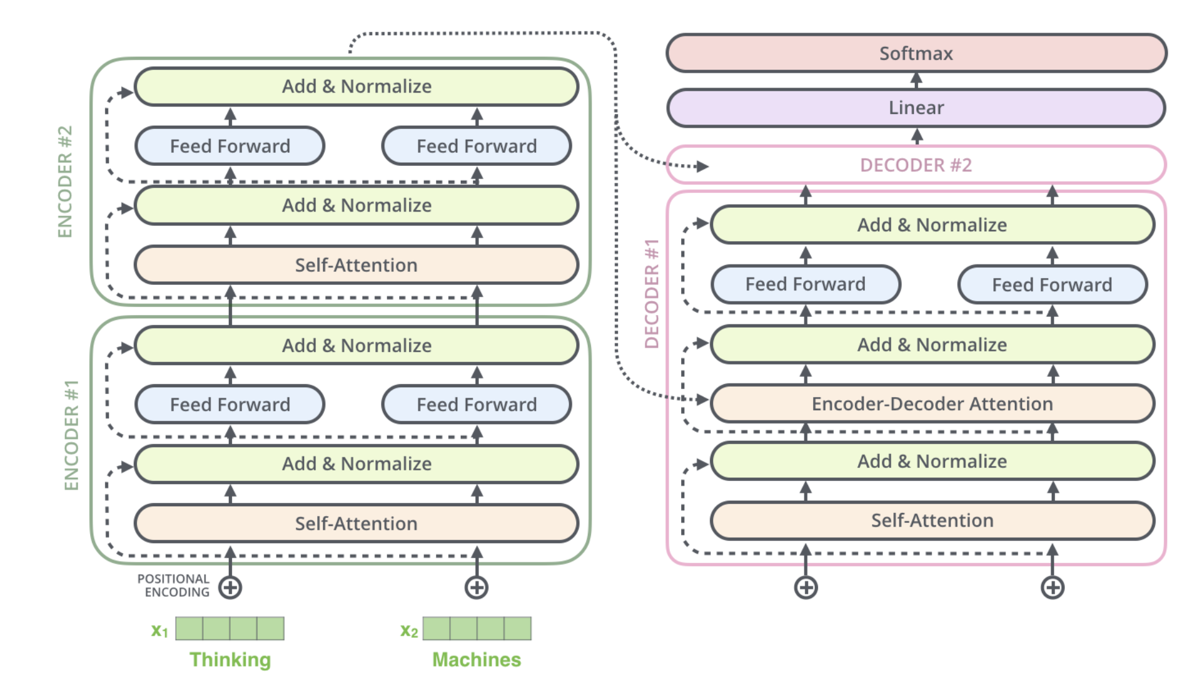
Transformer

